Slide 1




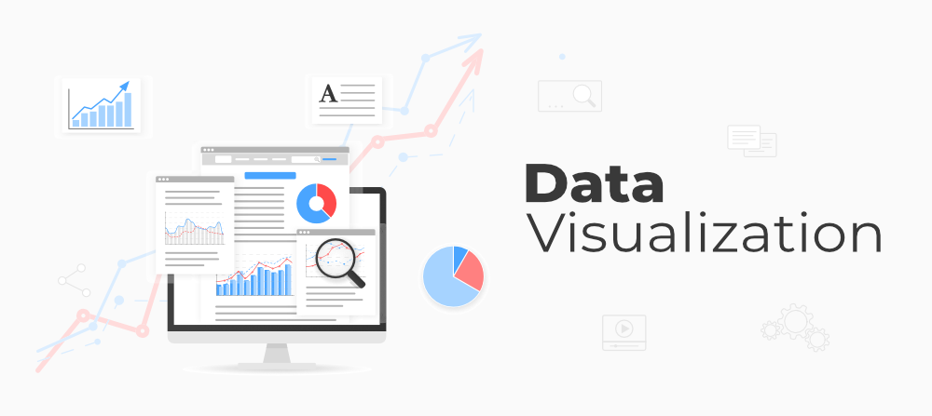
Data
Storage
Transformation
SQL Analytics
Visualisation

